Slide 1
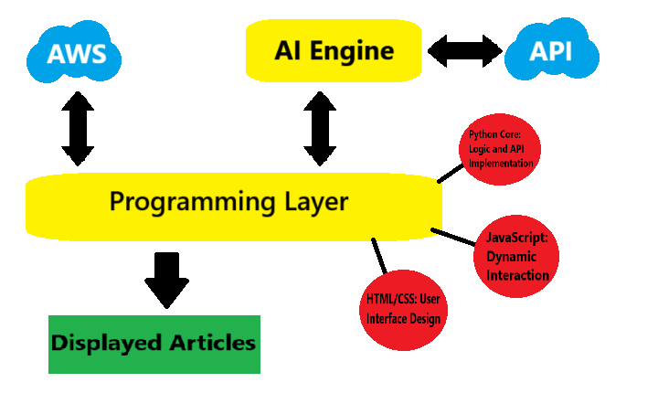
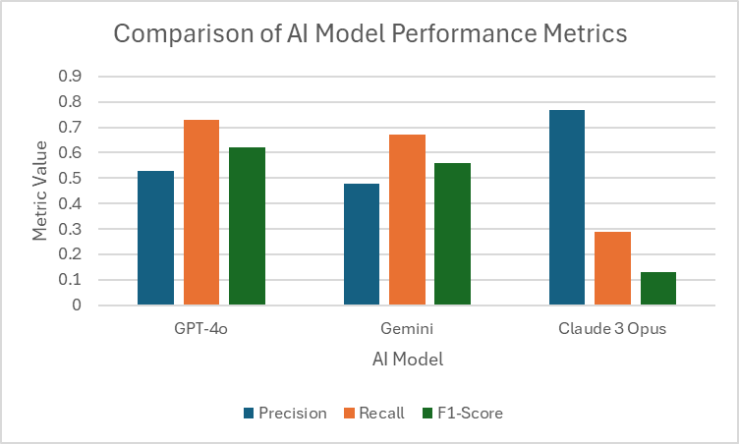
25-332
Automated Scanning and Understanding of New Posts
Team members: Kyle Vinod, Ryan Ta, Katie Martinez | Faculty adviser: Tom Ardoz, Ph.D. | Sponsor: VCU College of Engineering | Mentor: Tom Ardoz
Overview and Background
Analysis
Results
Retrieval results are determined if the articles are relevant and if they were received
Retrieval results are evaluated by testers and used to determine metric scores
Metric scores of each AI model are compared to determine the most reliable
GPT-4o had a precision of 0.53, recall of 0.73, and F1-Score of 0.62
Gemini had a precision of 0.48, recall of .67, and F1-Score of 0.56.
Claude Opus 3 had a precision of 0.77, recall of 0.29, and F1-Score of 0.13.
AI performed better with specific topics
Difficulty gathering relevant research articles and notes
Existing tools (Google Scholars, PubMed, etc) are helpful but can be overwhelming
Researchers need efficient filtering and highly relevant results
This AI-powered tool automates and improves research article discovery
Discussion
Methods
AI retrieved relevant articles with fast results and reliability
AI still suggested irrelevant articles
Future work includes improved parsing and filtering
The artificial intelligence (AI) tool is connected through AWS cloud data
Tested with three different Large Language Models: GPT-4o, Gemini, and Claude 3 Opus
The AI keeps track of each user to track their interests and give alerts for future articles
Models are determined by recall, precision, and F1-score metrics
Figure 1: AI System Architecture
Figure 2: Model Performance Comparison

